Slide 1

Welcome to FCC CKVL.
tinyurl.com/fccCKVL

Slide 2
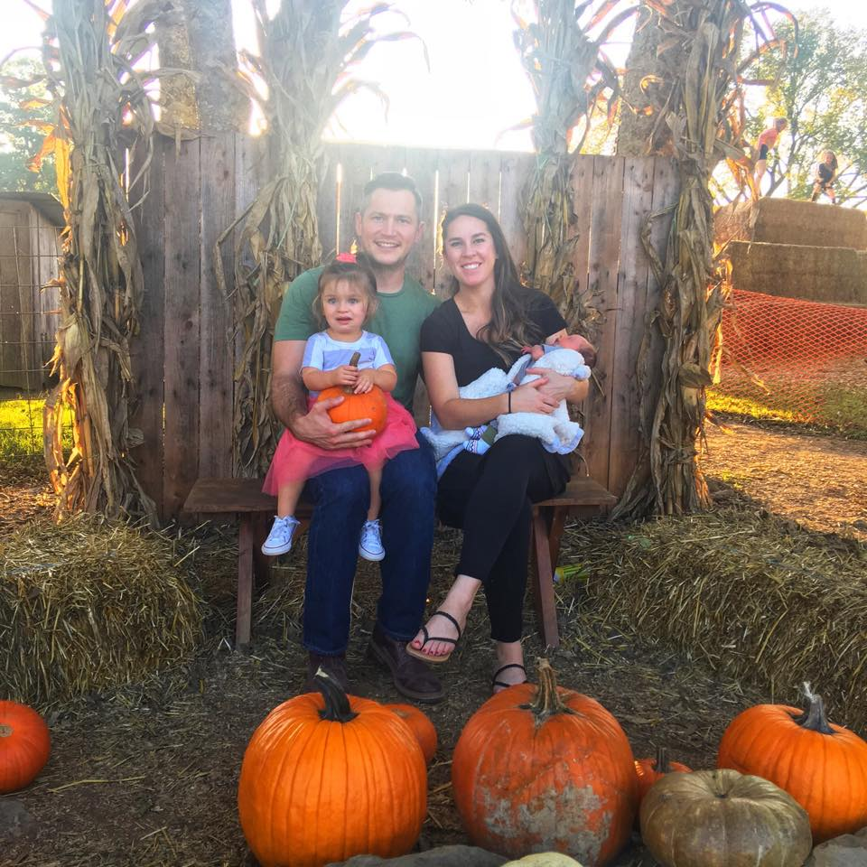
About Us:
James (Jay Watson)
Works at SAIC as a Developer
Goes to the Gym instead of eating Lunch with his team
Outside of work he spends time building his house.
Alex Clark
Graduated for UT Martin Fall 2015 with degree in CSCI.
Works at SAIC as a Software Test Engineer (Automation Wizard)
Outside of work enjoys playing Video Games and Guitar/Piano

Slide 3
Why freeCodeCamp CKVL?

Slide 4

Why we started?
Open sourced. Free.
Relevant instruction.
Project-based learning. aka build crap
Creates a learning community with accountability.
Provides a logical roadmap for becoming a developer.
Although a virtual community is great, a local community provides even more value.

Slide 5
How to learn?

Slide 6

How to learn
Must believe you can
Know how you learn best
Present information
different ways
Practice. Practice.
Practice. Or repetition.
Test ability to summarize.
Real world problems.

Slide 7
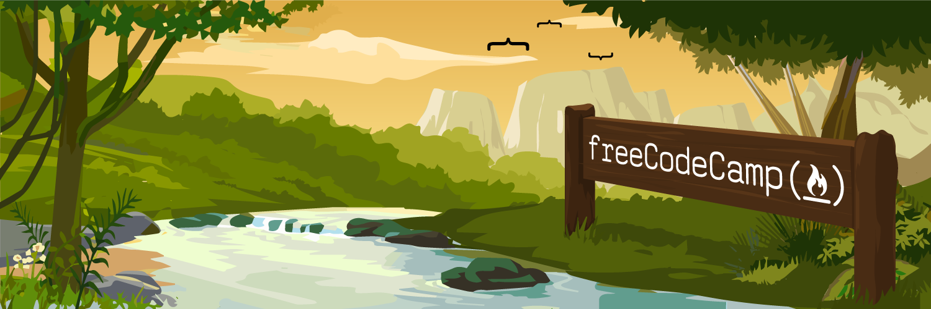
What is freeCodeCamp? Curriculum Review by Alex

Slide 8
freeCodeCamp Curriculum
Responsive Web Design Certification (300 hours)
Javascript Algorithms And Data Structures Certification (300 hours)
Front End Libraries Certification (300 hours)
Data Visualization Certification (300 hours)
Apis And Microservices Certification (300 hours)
Information Security And Quality Assurance Certification (300 hours)
Coding Interview Prep (Thousands of hours of challenges)
Learn more here

Slide 9




Tools we Use

Slide 10
Intro to HTML, CSS, & JavaScript By Jay

